Slide 1

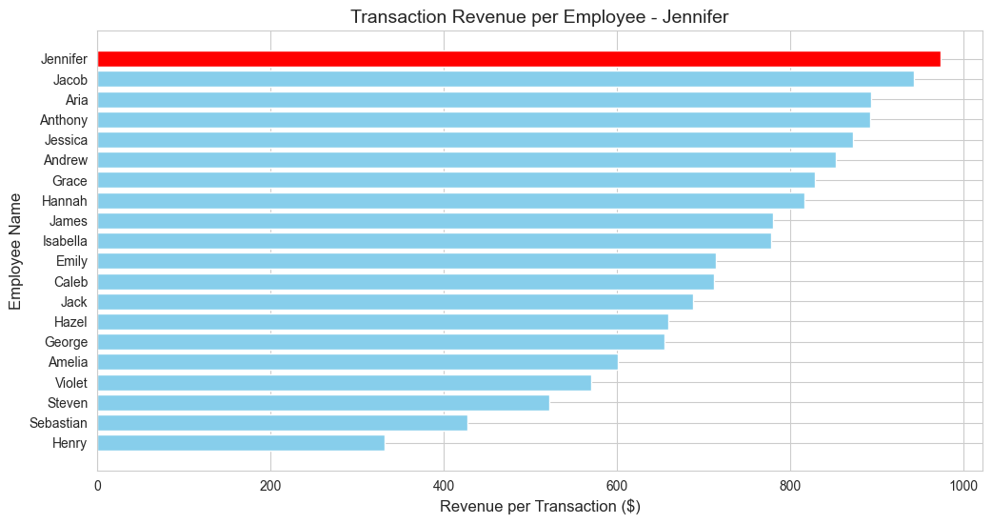
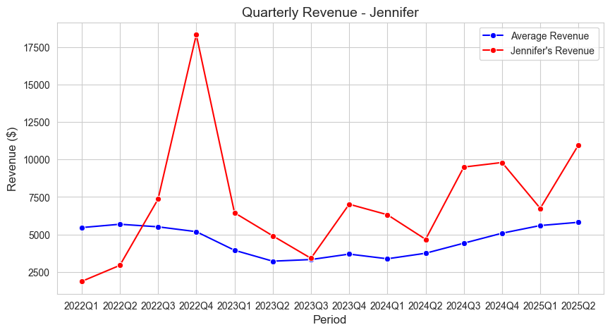
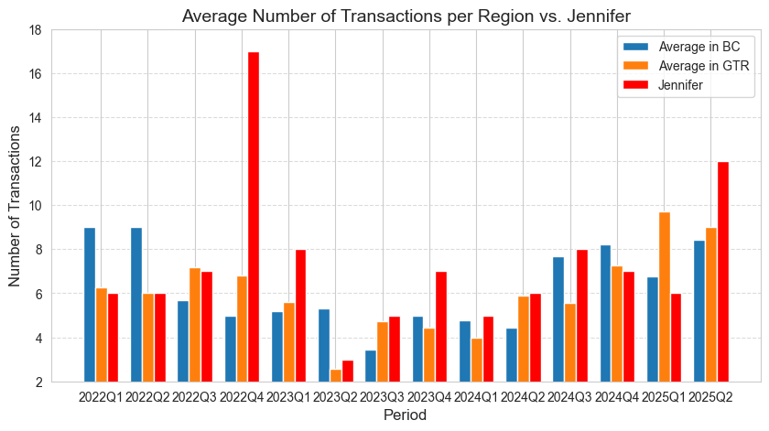
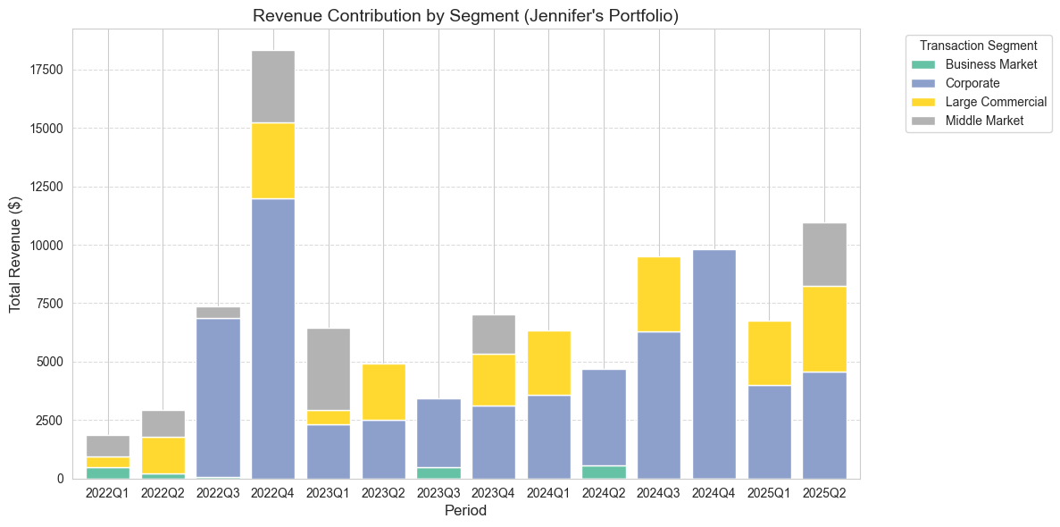
Individual Scorecard Jennifer
Focus on Consistency
Excellent
Current Strengths
High revenue efficiency – Jennifer consistently generates the highest revenue per transaction.
Benchmark leader – Outpaces peers, setting a strong standard for success.
Strategic impact – Major contributor in Business Market & Corporate segments, driving revenue growth.
Required Strategic Behaviors
Revenue consistency – Address fluctuations by replicating strategies from successful quarters.
Team collaboration – Share insights to enhance overall team performance.
Sustainable growth – Set steady, achievable goals to maintain long-term success.
Segment optimization – Explore ways to improve revenue contributions from Large Commercial & Middle Market segments.
Excellent
Focus on Large Corporate
2025Q2

Slide 2
Strategic Next Steps for the Data Project
Upgrade Methodology
Management Dashboard
External Data Integration
Apply business expertise to refine input variables for better predictions.
Use monthly data for deeper analysis and add more years of available data.
Validate forecasts with random forests and other ML models.
Explore time-series methods for long-term predictions (e.g., ARIMA, LSTM).
Build an interactive dashboard for revenue forecasts and KPI analysis (PowerBI, Tableau, etc.).
Integrate dynamic slicers, allowing flexible breakdowns across key dimensions such as region, period, employee, and business segment.
Enable real-time monitoring for quick insights via a live cloud database and CRM.
Include alerts for anomalies.
Incorporate economic indicators (GDP, interest rates) and industry trends data.
Incorporate manager and sales forecasts for accuracy.
Include competitor data for benchmarking.
Factor in seasonal and macroeconomic trends.

